Slide 1
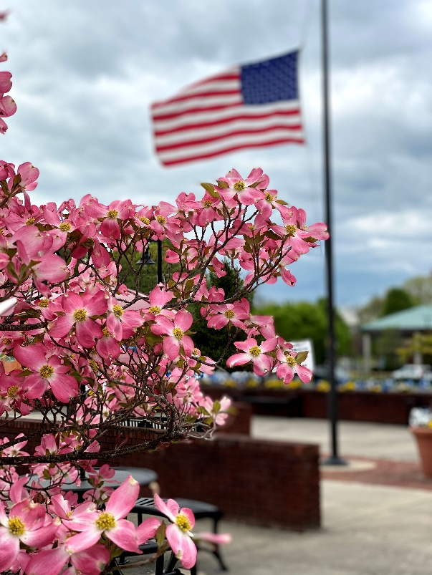
FY2022 Budget
Briefing
Vinton Town Council
May 18, 2021

Slide 2
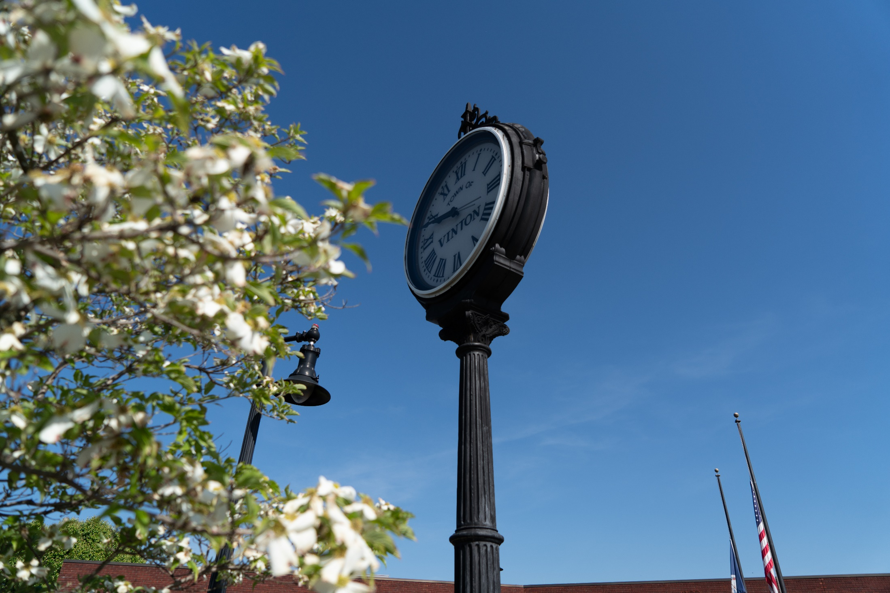
FY2022 BUDGET
 | Adopted FY21 | Proposed FY22 | % Variance
General Fund | $7,168,550 | $8,032,258 | 12.05%
Grant Fund | 4,000 | 384,800 | 9,520.00%
Utility Fund | 3,826,500 | 4,513,595 | 17.96%
Capital Fund | 175,000 | 835,000 | 377.14%
Stormwater Fund | 489,723 | 414,328 | (17.05%)
Total | $11,663,773 | $14,179,981 | 21.57%

Slide 3
FY2022 BUDGET
On June 16, 2020, Town Council approved and ratified the Town of Vinton Strategic Plan for 2020-2025. Preparation of this Budget was guided by the following three goals established in the Strategic Plan:
  Enhance the Town’s infrastructure and livability
  Maintain an efficient and high-performing government
  Ensure the Town’s continued financial viability by actively pursuing quality economic development

Slide 4
FY2022 BUDGET
Proposed Budget Highlights
  Revenue Recovery and Economic Growth
  Continued Economic Development
  Implementation of New Classification Plan
  1.0% Cost of Living Adjustment for all employees
  Continue to Offer a Free Employee Health Plan
  Year 1 Allocation of 7-Year Capital Improvement Plan

Slide 5
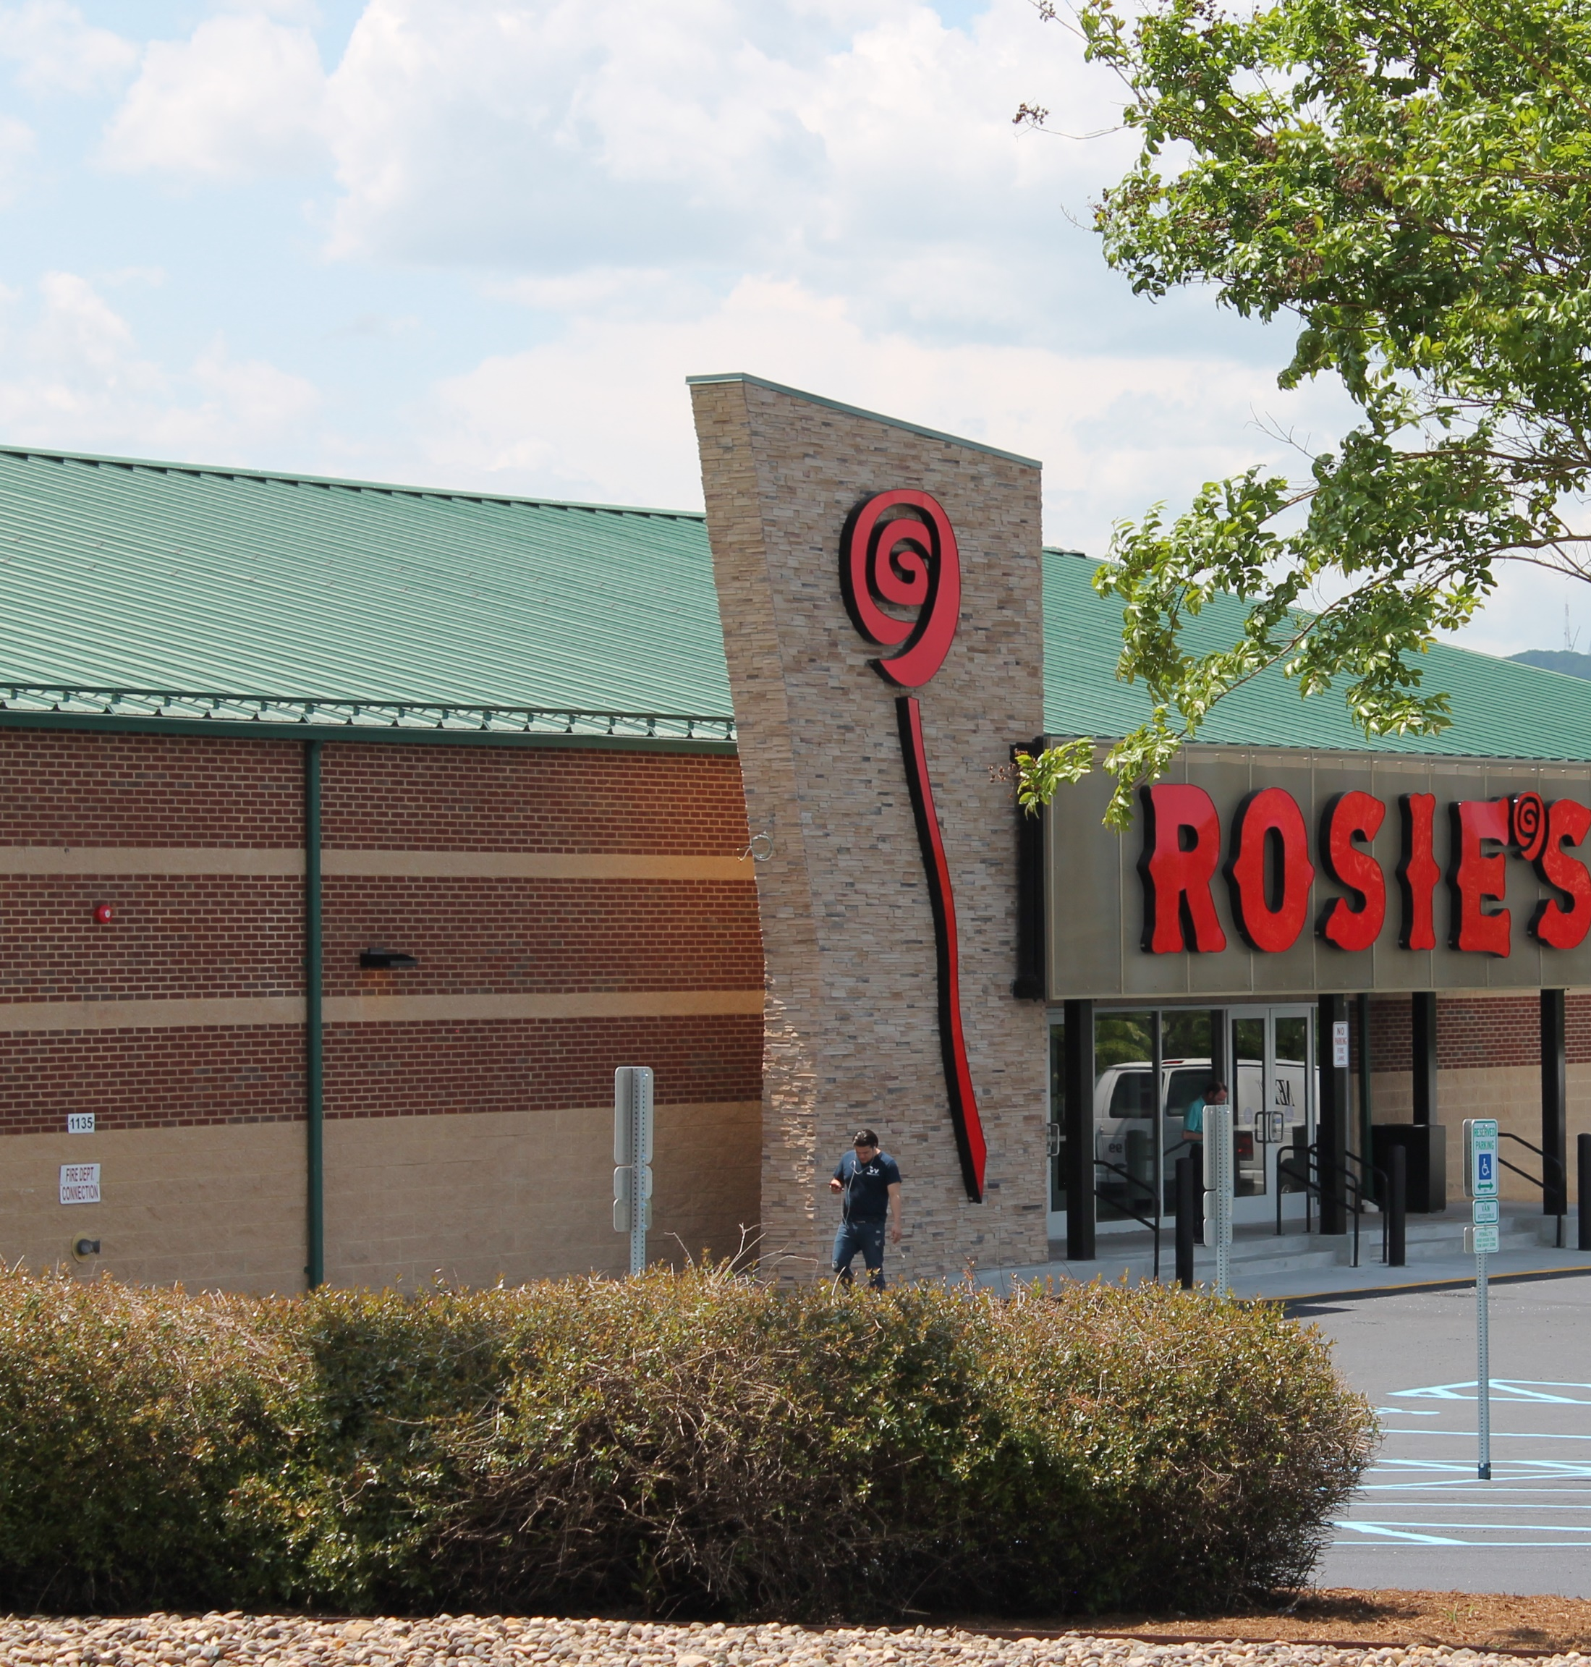
FY2022 BUDGET

Slide 6
FY2022 BUDGET
Business Portion of General Fund Revenue Budget:
Real Estate Tax $ 75,640
Business Personal Property $ 184,644
Communication Tax $ 636,409
Business License Tax $ 647,071
Franchise License Tax $ 27,584
Bank Stock Tax $ 207,466
Pari-Mutuel Tax $ 550,000
Admissions Tax $ 1,127
Transient Occupancy Tax $ 3,214
Prepared Food Tax $ 1,282,197
Cigarette Tax $ 116,969
State Sales Tax $ 1,157,416
TOTAL $ 4,889,737
PERCENTAGE OF BUDGET 60.88%

Slide 7
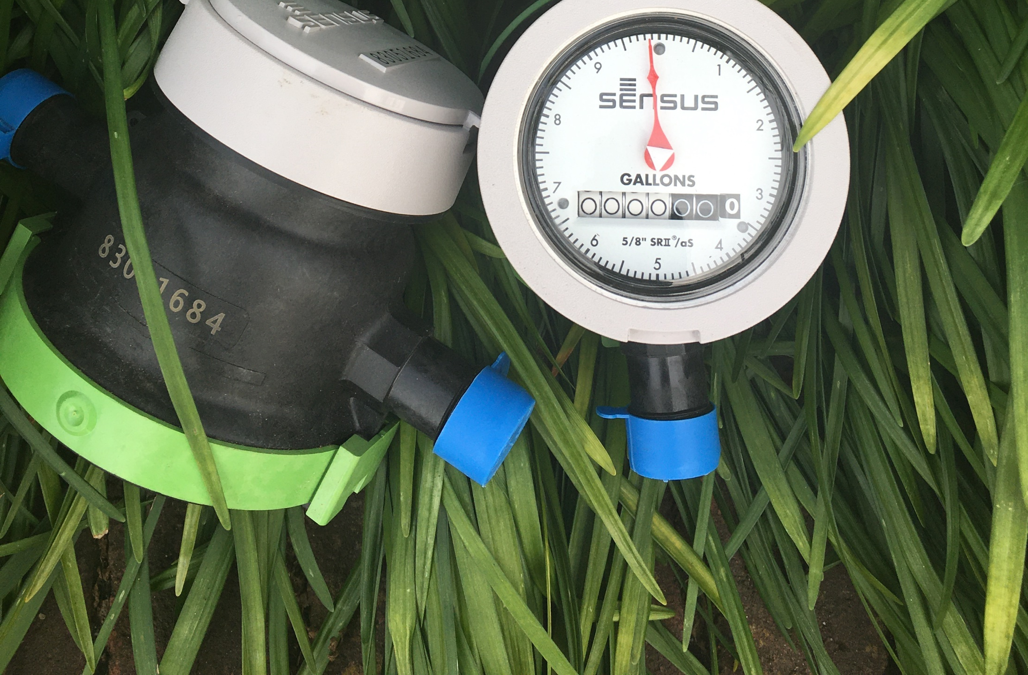
FY2022 BUDGET
As part of the Davenport & Company Rate Study presented fall of 2019, Town Council approved a multi-year rate schedule which includes an 8.00% service charge increase and an 6.00% volumetric rate increase each July 1 through fiscal year 2023.

Slide 8
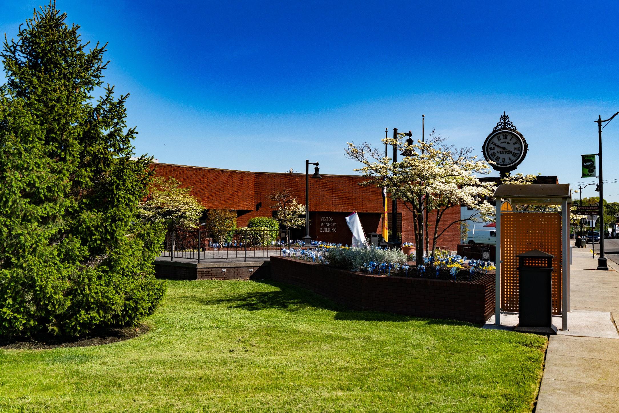
FY2022 BUDGET

Slide 9
FY2022 BUDGET
Department | Actual Full Time Positions FY18-19 | Actual Full Time Positions FY19-20 | Budgeted Full Time Positions FY20-21 | Budgeted Full Time Positions FY21-22
Administration | 3.00 | 3.00 | 3.00 | 3.00
Finance | 5.00 | 5.00 | 5.00 | 6.00
Fire/EMS | 11.00 | - | - | -
HR & Risk Management | 1.00 | 1.00 | 1.00 | 1.00
Planning & Zoning | 3.00 | 3.00 | 3.00 | 4.00
Police Department | 26.00 | 27.00 | 26.00 | 26.00
Public Works | 33.00 | 33.00 | 30.00 | 30.00
Special Programs | 1.00 | - | - | -
War Memorial | 2.00 | - | - | -
Community Programs | - | 3.00 | 3.00 | 3.00
TOTAL | 85.00 | 75.00 | 71.00 | 73.00

Slide 10
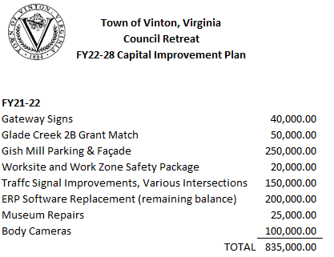
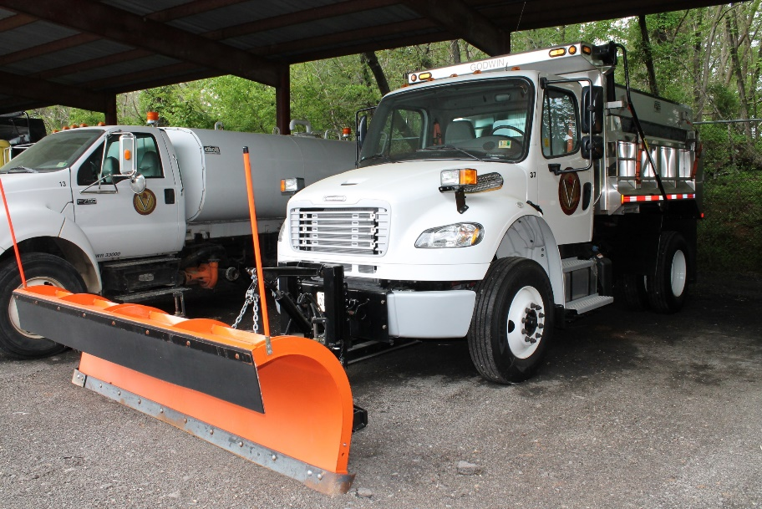
FY2022 BUDGET
As a priority in the FY22 Proposed Budget, Town Management presented a 7-Year Capital Improvement Plan that is balanced within forecasted available funding.

Slide 11
FY2022 BUDGET
Original Issue Amount | Series/Description | Interest Rates | Maturity | Outstanding Balance as of June 30, 2021 | Principal Payment FY21-22 | Interest Payment FY21-22 | Total Debt Payment FY21-22
 | General Fund
$ 2,228,408.87 | 2013 Carter Bank Refunding | 2.05% | 11/1/2024 | $ 921,595.75 | 225,386.71 | 16,582.49 | 241,969.20
$ 702,000.00 | Series 2016A VML/VACO Refunding | 2.05% | 2/1/2027 | $ 428,000.00 | 69,000.00 | 8,774.00 | 77,774.00
$ 73,180.00 | RCACP*** | 2.46% | 9/30/2022 | $ 11,200.00 | - | - | -
$ 257,602.00 | VML 2017 Equipment Lease Purchase | 2.43% | 12/29/2024 | $ 169,693.02 | 36,315.98 | 3,926.95 | 40,242.93
$ 157,053.42 | VML 2018 Knucklebook Lease Purchase | 3.10% | 7/27/2025 | $ 104,802.01 | 22,051.99 | 3,079.27 | 25,131.26
$ 305,000.00 | Refunding of Series 2006A VRA, 2021 Series | 1.66% | 6/30/2027 | $ 305,000.00 | 45,000.00 | 13,885.73 | 58,885.73
 |  |  |  | $ 1,940,290.78 | $ 397,754.68 | $ 46,248.44 | $ 444,003.12
 | Utility Fund
$ 1,250,704.36 | 2003 VRLF Wolf Creek | 3.3%* | 7/1/2024 | $ 286,943.95 | 78,657.93 | 8,825.58 | 87,483.51
$ 2,479,633.00 | 2004 VRLF Wolf Creek | 3.1%* | 10/1/2026 | $ 855,579.26 | 144,989.73 | 25,407.93 | 170,397.66
$ 1,210,000.00 | 2006 VRLF Lindenwood | 3.0%* | 3/1/2026 | $ 382,398.20 | 71,848.06 | 11,301.80 | 83,149.86
$ 294,515.72 | 2015 VRA/WVWA - Tinker Creek | 2.35% | 9/1/2032 | $ 205,952.20 | 16,005.54 | 4,705.88 | 20,711.42
$ 1,786,000.00 | 2016B VML/VACO Refunding | 2.05% | 8/1/2027 | $ 1,338,000.00 | 181,000.00 | 25,573.75 | 206,573.75
$ 488,639.00 | VML 2017 Equipment Lease Purchase | 2.43% | 12/29/2024 | $ 254,644.44 | 70,571.56 | 5,764.11 | 76,335.67
$ 1,225,000.00 | Refunding of Series 2013, 2021 Series | 1.66% | 6/30/2033 | $ 1,225,000.00 | 96,000.00 | 17,454.21 | 113,454.21
$ 4,429,000.00 | New Money 2021 Series | 1.66% | 6/30/2031 | $ 4,429,000.00 | 420,000.00 | 63,105.87 | 483,105.87
 |  |  |  | $ 8,977,518.05 | $ 1,079,072.82 | $ 162,139.13 | $ 1,241,211.95
 | Stormwater Fund
$ 242,703.00 | 2019 Street Sweeper Lease Purchase | 3.02% | 4/19/2026 | $ 178,473.93 | 33,587.63 | 5,138.23 | 38,725.86
 |  |  |  | $ 178,473.93 | $ 33,587.63 | $ 5,138.23 | $ 38,725.86
*Interest rate negotiated down to 1.0%

Slide 12
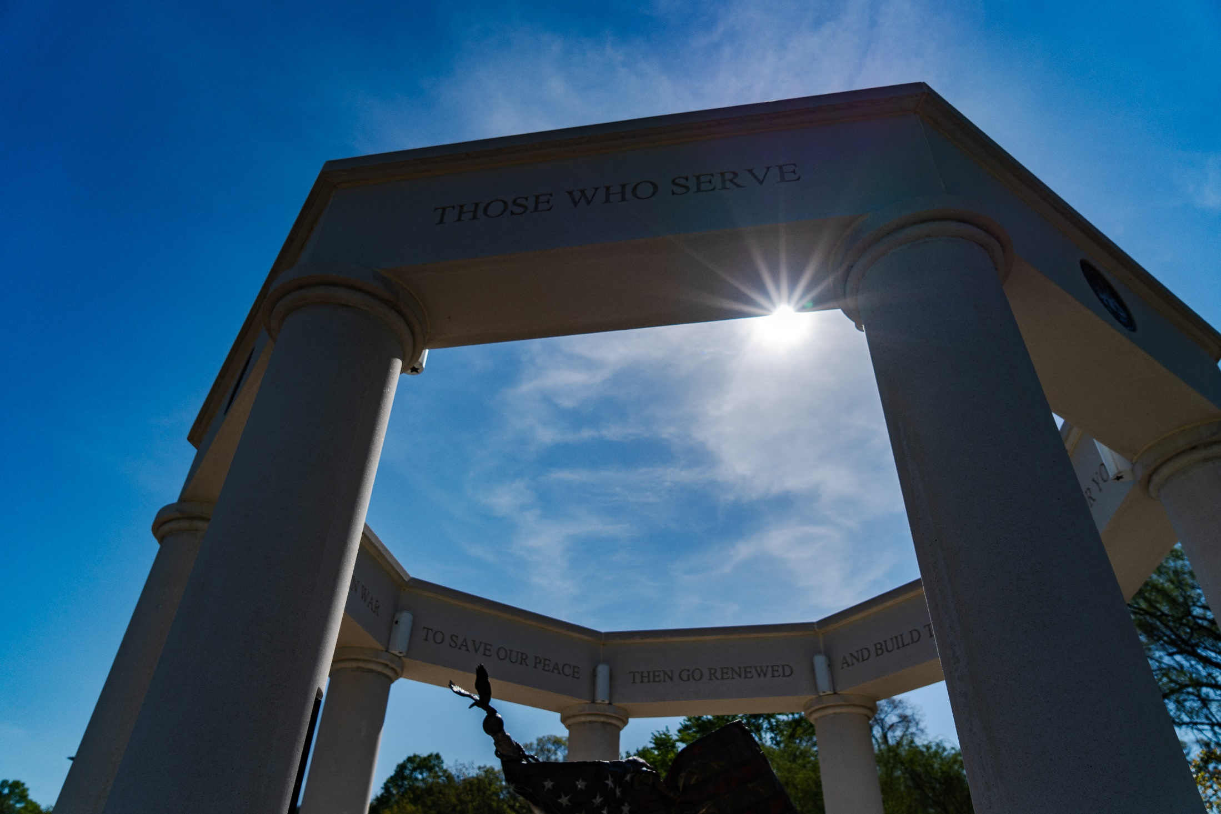
FY2022 BUDGET
TOWN OF VINTON FY2022 TOTAL BUDGET
 | General Fund | Grant Fund | Utility Fund | Capital Fund | StmWater Fund | Total | % of Total
Expenditures
Personnel | $4,117,718 | - | $1,324,630 | - | $251,605 | $5,693,953 | 40.15%
Operating | 2,399,895 | 384,800 | 1,462,754 | - | 91,496 | 3,954,145 | 27.89%
Capital | 313,350 | - | 262,750 | 835,000 | 32,500 | 1,828,400 | 12.89%
Debt | 444,131 | - | 1,256,297 | - | 38,727 | 1,739,155 | 12.26%
Transfers | 757,164 | - | 207,164 | - | - | 964,328 | 6.81%
Contingency | - | - | - | - | - | - | -%
Total Expenditures | $8,032,258 | $384,800 | $4,513,595 | $835,000 | $414,328 | $14,179,981 | 100.00%

Slide 13
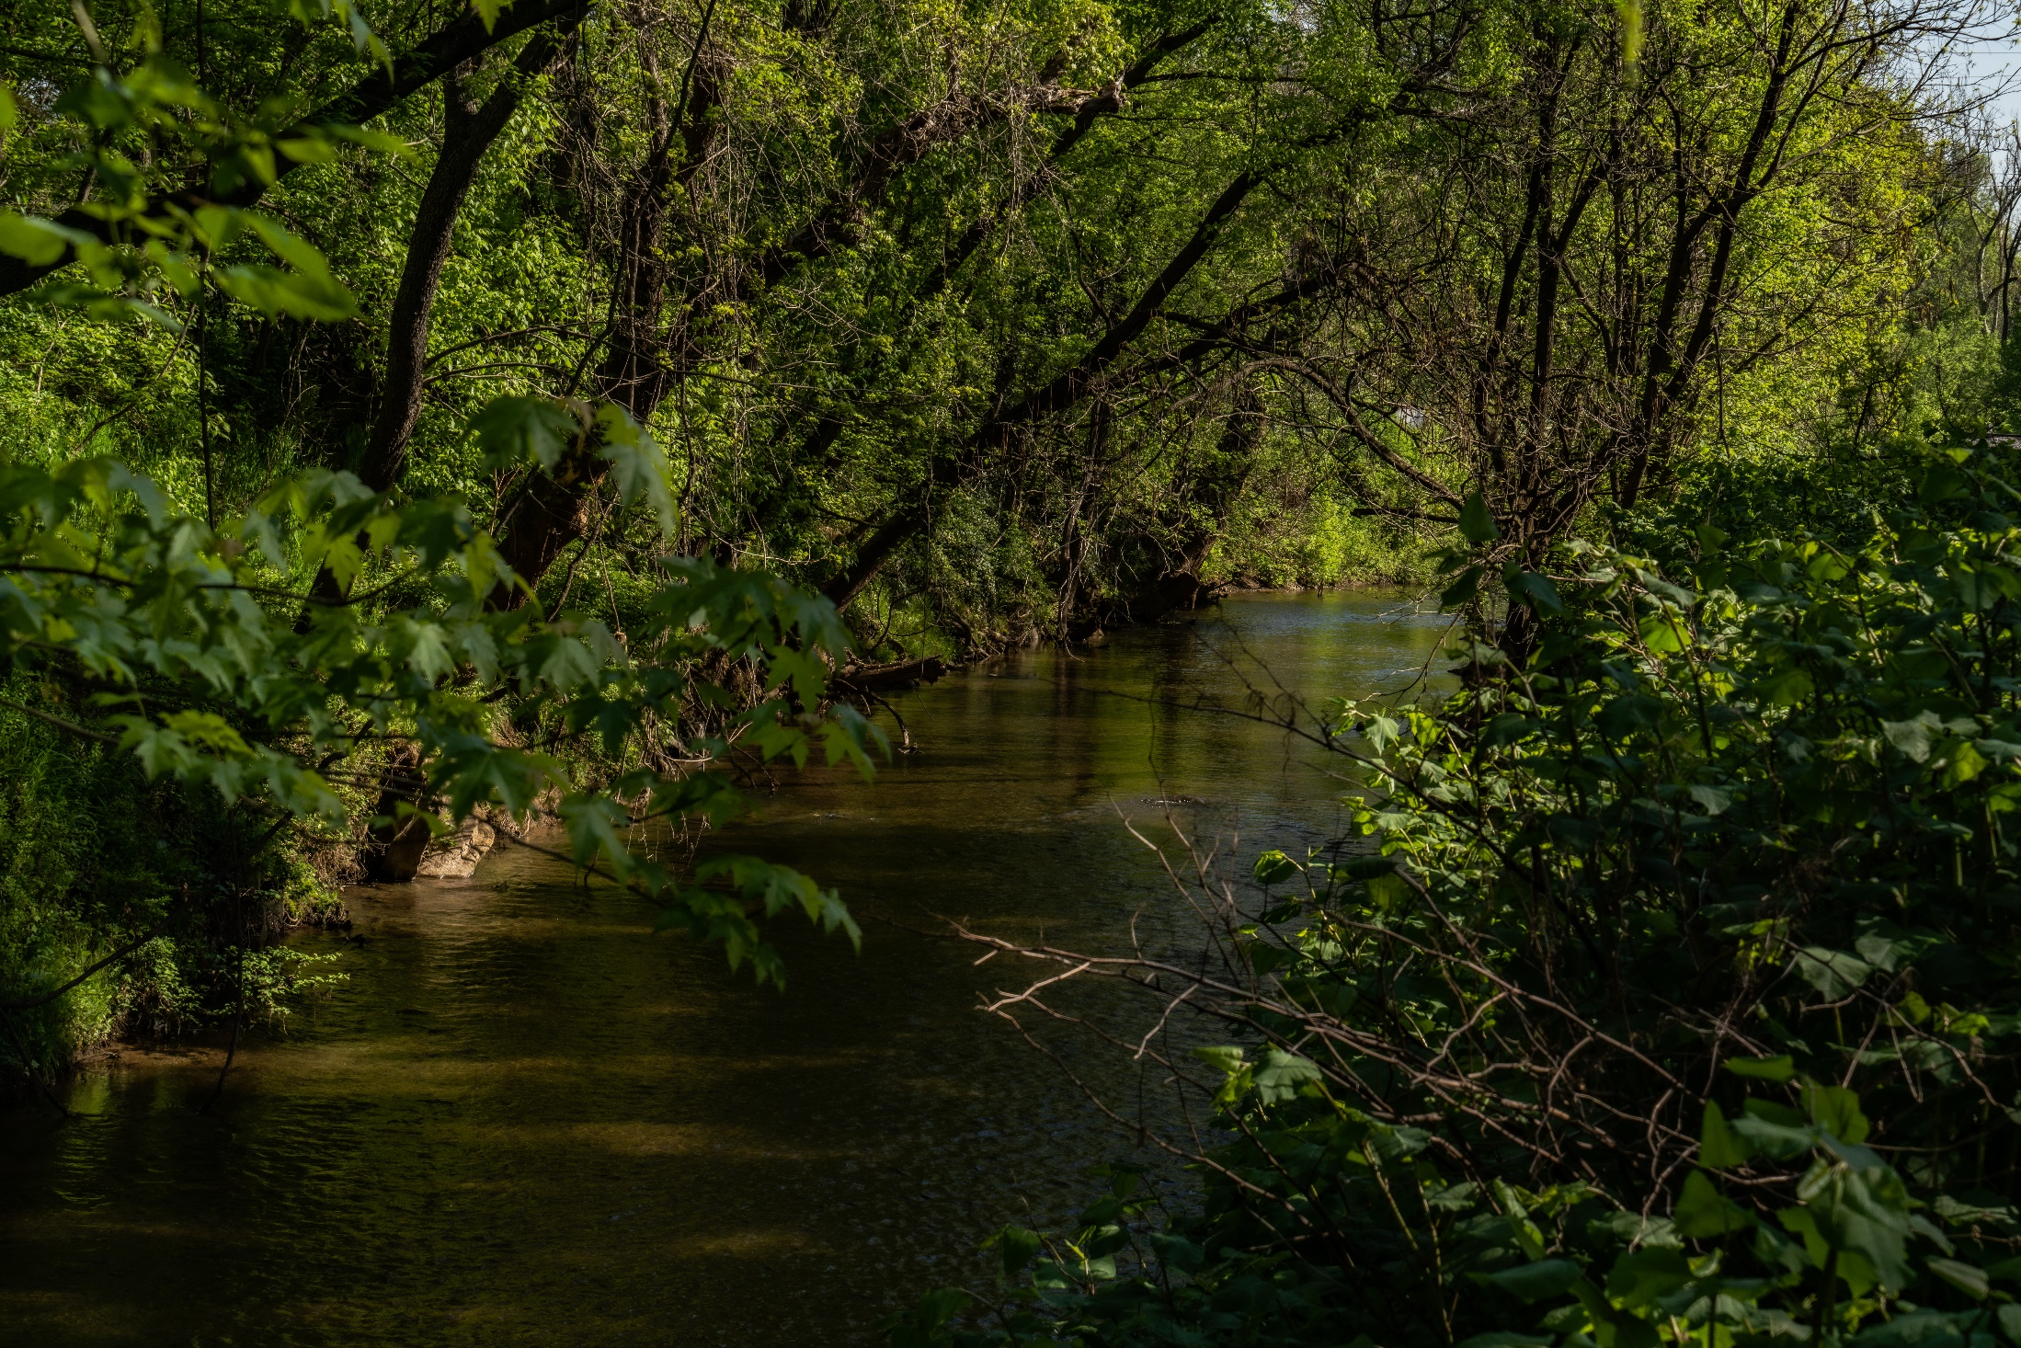
FY2022 BUDGET

Slide 14
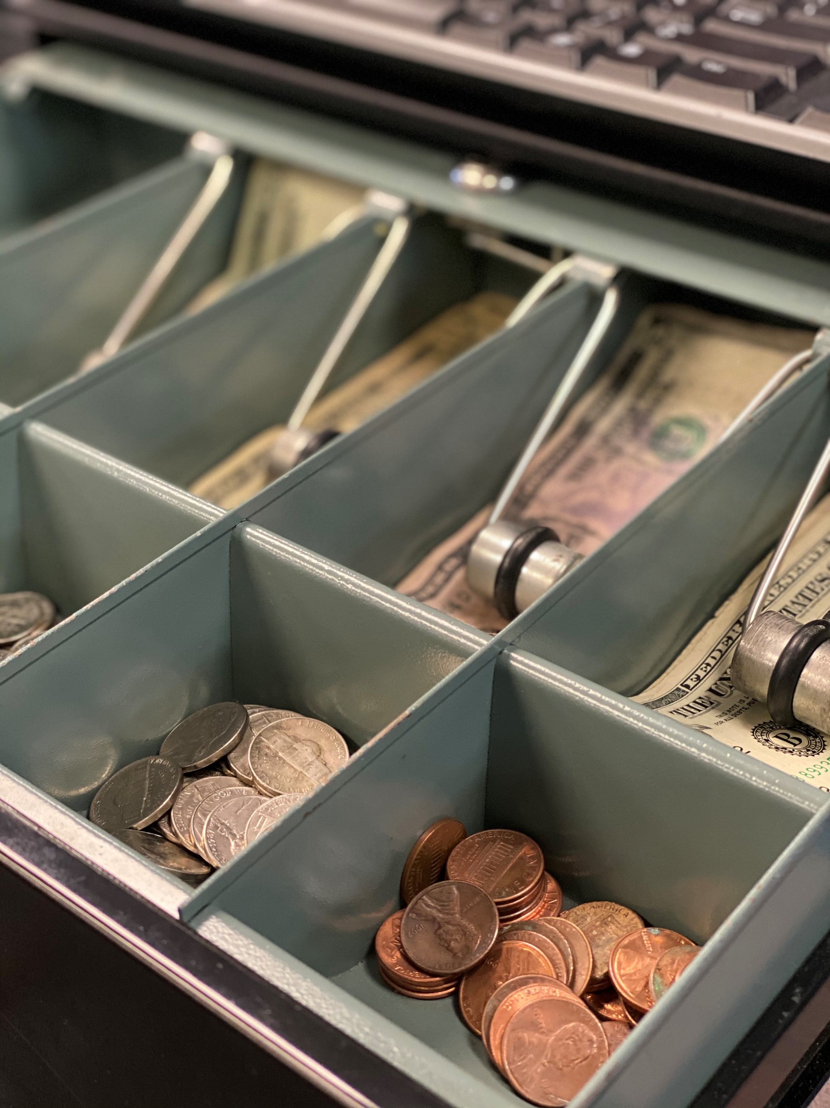
General Fund Balance (Unassigned)
Unassigned Fund Balance as of 6/30/2020 $3,698,974
Projected Decrease for 6/30/2021 (725,000)
Projected Ending Fund Balance as of 6/30/2020 $2,973,974
Percentage of Annual Budget: 3.03%
Fund Balance as # of Months: 4.44
Fund Balance Policy: 2 Month Floor with 4 Month Target
Excess Fund Balance may be transferred for capital or one-time projects.

Slide 15
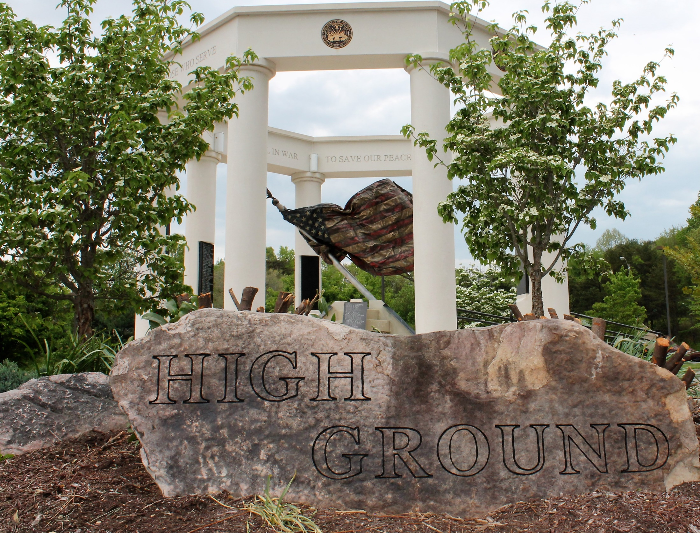
FY2022 BUDGET
BUDGET CALENDAR REMAINING
MAY 18, 2021 | Budget Briefing – Council Meeting
JUNE 1, 2021 | Public Hearing on FY2022 Proposed Budget
JUNE 15, 2021 | Adoption of FY2022 Budget

Slide 16
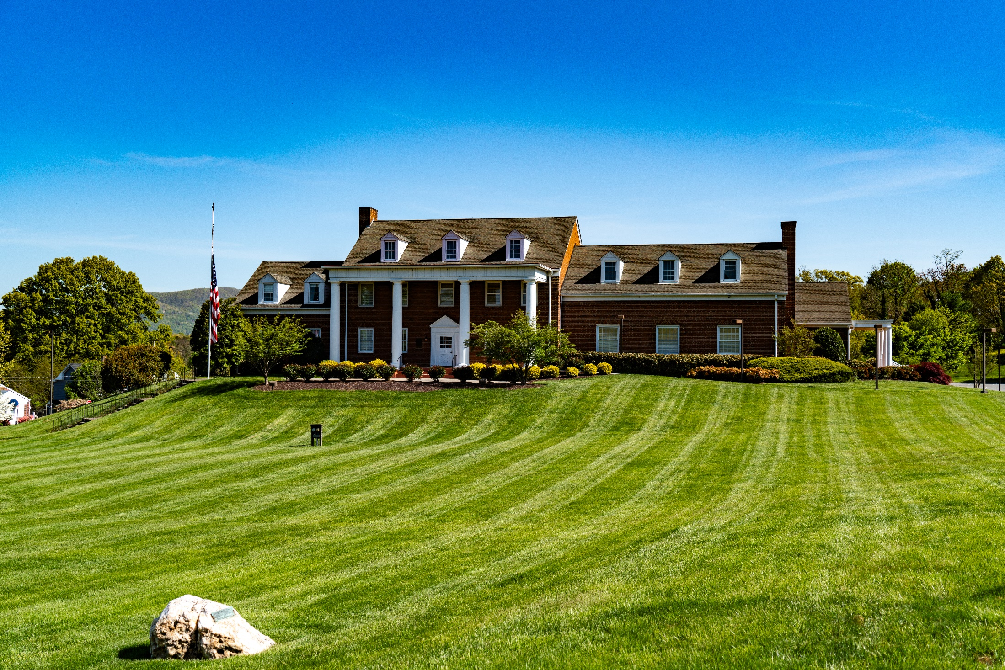
Questions? Thank you!

